Slide 1
Are we free?
Jessica Castellani October 12th, 2020

Slide 2
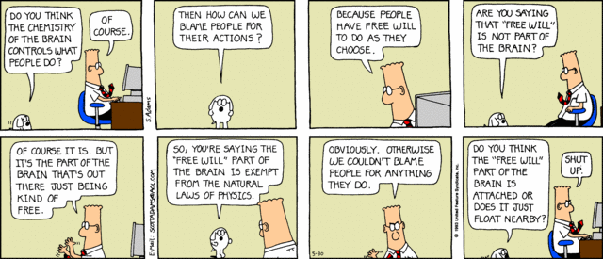

Slide 3
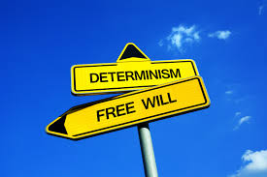
https://www.youtube.com/watch?v=vCGtkDzELAI- Oedipus Rex and Determinism

Slide 4
How does agent causation work with the problem of interaction?
how does a nonphysical mind affect and make a physical thing move? Think about robots, isn’t our free choice something that makes us uniquely human?

Slide 5
https://www.youtube.com/watch?v=n0tLRO8_qRI
“I believe that every particle of dust that dances in the sunbeam does not move an atom more or less than God wishes” ― Charles Spurgeon

Slide 6
Born this way?
https://www.youtube.com/watch?v=RjX-KBPmgg4

Slide 7
We will see next week that Locke states that you cannot punish a person for something they don’t remember doing. This is because they weren’t in their right mind.
Think about the insanity defense.
Were they free to make the right choice?

Slide 8
Some basic problems of free will comes down to moral responsibility.
We think of people as morally responsible for what they do because they choose to do it freely.
We don’t blame them for what they are forced to do, if they had no choice.

Slide 9
With science it is becoming easier to see ourselves as causally determined. Whether it be biological, or physiochemical, neurological.
If there were a creature that with superior intelligence, maybe aliens, that knew everything about us could they tell our every move?
https://www.youtube.com/watch?v=OjCt-L0Ph5o – Libet Free Will

Slide 10
This is Pierre Simon de Laplace’s argument.
He ask’s how we can be apart of such a universal system that is subject to laws of nature, yet we are not?
“All events, even those which because of their small scale do not appear to keep to the great laws of nature, are just as necessary a result of those laws as are the revolutions around the sun.” pg. 319
It is because we are ignorant of all these causes that we attribute them to will, or final causes (an end state or goal) “I went to school because I want a degree”
Or up to chance if it seems to happen regularly or in some disorderly way.
This is because, he says, the principle of sufficient reason, Nothing is without reason, or cause.

Slide 11

The Buddhist perspective of Free Will
https://www.youtube.com/watch?v=KqJJXXAhciU
Alan B. Wallace- American Author and Expert in Tibetan Buddhism

Slide 12
Are we free? Please say so on your note card.

